Slide 1
Design and Verification of Cache with Cache coherency using Dragon protocol
By
Sai Krishna Ravauri
Subrat Mahalik
Dhanush T
Lokesh Astakar

Slide 2
Project Proposal & Design Details
To Design and verify a single level cache maintaining cache coherency.
Dragon protocol is used to ensure cache coherency.
Write back cache.
LRU replacement policy used for eviction.
Simulation environment : System Verilog(Questa Sim), Mentor Veloce.

Slide 3
Top Level Design(change pic)

Slide 4
System Verilog Constructs used
Design
Interfaces
Typedef enum
Always_ff
Struct
Packages
Verification
Assertions
Randomization()

Slide 5
Design Details
Processor:-
Issues 40 bit instructions(Read/Write, Address,Data)
First 45 instructions are deterministic and the rest are randomly generated.
Checks at every negedge of the clock for the stall signal and issues instructions.
Interfaces
Proc_cache | Common bus (between Data memory and cache)
Read/Write | Address 2bytes
Address 2 bytes | Data 8 bytes
Data 1bytes | Bus Read, Bus update
Hit/Miss | Shared
Stall | Read,Write

Slide 6
Design Details conti…
Cache
4 way set associative cache.
Cache size is 4 KB and 256 cache lines.
4 blocks in each way of the set.
Cache Block contains Tag (6 bits) , LRU bit(2 bits) , State, Data.
Memory
Memory size is 256KB
Randomly generated the Data and stored it in a memory image.
Readmemh() & writememh() functions are used to fetch and write the data from/to the memory image respectively.

Slide 7
Cache controller(small changes in pic..use Reset in)

Slide 8
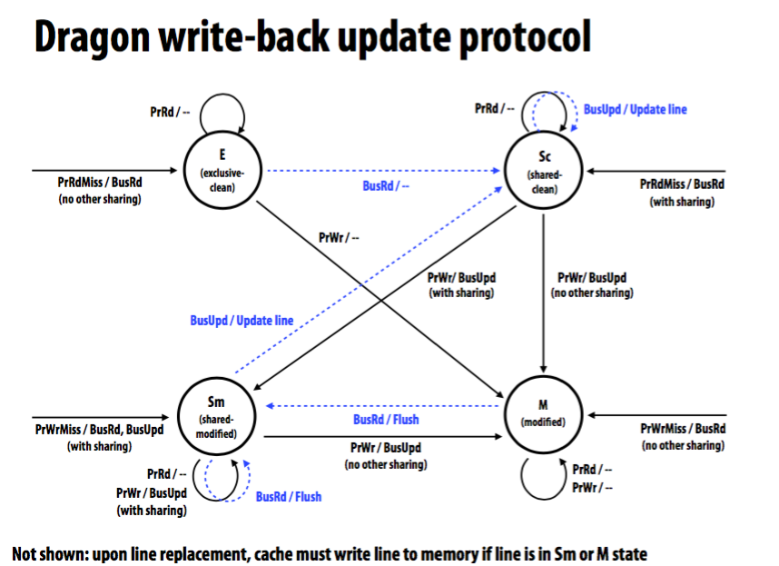
Dragon update protocol
Source: CMU

Slide 9
Verification Plan(more on this)
Bottom Up Approach is followed.
Individually verified Cache Controller, Protocol and Top Module.
Checker is used to validating input data and state.

Slide 10
Assertions
Immediate and Concurrent Assertions are used.
Immediate Assertions are used to keep track of State of the Cache Block.
Concurrent Assertions are used to validate Data .

Slide 11
Simulation on Questa and Puresim
BUGS:

Slide 13
Functional Coverage

Slide 14
Emulation on Veloce

Slide 15
Results and Futurework

Slide 16
References

Slide 17
Thank you…..

